Slide 1
Interncareer
Devops internship

Slide 2
Content
Problem statement
System Requirements
EC2 Instances
Creating a IAM user
Installation of terraform
Writing the terraform script for the infrastructure
Hosting the website
Storing the data in s3
Conclusion

Slide 3
Problem statement:
Implement infrastructure as code (IaC) using Terraform to provision and manage cloud resources for a scalable web application deployment.

Slide 4
System Requirements
1.launch ec2 instance
Login to AWS Console
Navigate to EC2.
Click "Launch Instance."
Choose the "t2.micro" instance type.
Configure other settings (VPC, security groups, key pair, etc.).

Slide 5
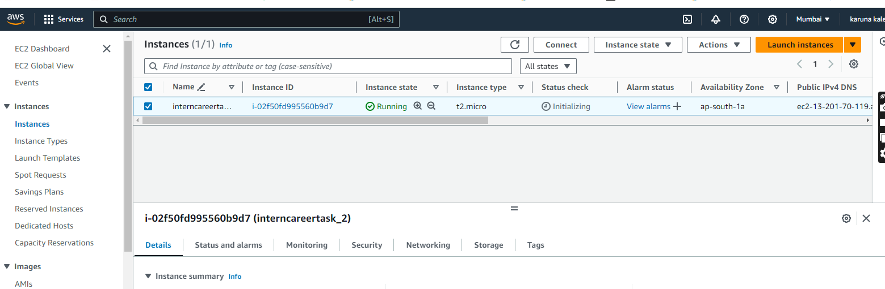
Created the ec2 instance

Slide 6
Terraform
Terraform is an infrastructure-as-code software tool created by HashiCorp. Users define and provide data center infrastructure using a declarative configuration language known as HashiCorp Configuration Language (HCL), or optionally JSON.
Terraform manages external resources (such as public cloud infrastructure, private cloud infrastructure, network appliances, software as a service, and platform as a service) with "providers". HashiCorp maintains an extensive list of official providers, and can also integrate with community-developed providers.^{[4]} Users can interact with Terraform providers by declaring resources^{[5]} or by calling data sources.^{[6]} Rather than using imperative commands to provision resources, Terraform uses declarative configuration to describe the desired final state

Slide 7
2.Installation of terraform
sudo curl -fsSL https://apt.releases.hashicorp.com/gpg | sudo apt-key add -
sudo apt-add-repository "deb [arch=amd64] https://apt.releases.hashicorp.com $(lsb_release -cs) main"
sudo apt-get update && sudo apt-get install terraform
Verify : terraform version

Slide 8
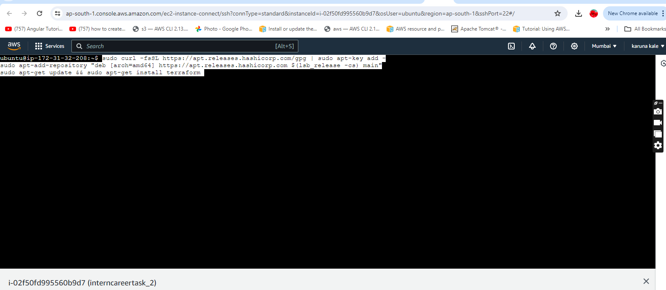
Installing terraform in the instance:

Slide 9
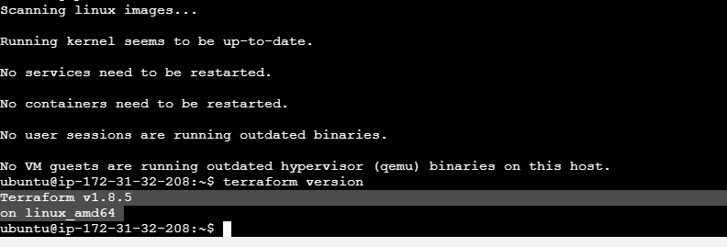
Terraform installed:

Slide 10
IAM
Identity management (IdM), also known as identity and access management (IAM or IdAM), is a framework of policies and technologies to ensure that the right users (that are part of the ecosystem connected to or within an enterprise) have the appropriate access to technology resources. IdM systems fall under the overarching umbrellas of IT security and data management. Identity and access management systems not only identify, authenticate, and control access for individuals who will be utilizing IT resources but also the hardware and applications employees need to access.

Slide 11
IAM user
User access enables users to assume a specific digital identity across applications, which enables access controls to be assigned and evaluated against this identity. The use of a single identity for a given user across multiple systems eases tasks for administrators and users. It simplifies access monitoring and verification and allows the organizations to minimize excessive privileges granted to one user. Ensuring user access security is crucial in this process, as it involves protecting the integrity and confidentiality of user credentials and preventing unauthorized access. Implementing robust authentication mechanisms, such as multi-factor authentication (MFA), regular security audits, and strict access controls, helps safeguard user identities and sensitive data. User access can be tracked from initiation to termination of user access.

Slide 12
3.Creating IAM user:
1.access to IAM consule
Create users->name of the user->attach the required policy

Slide 13
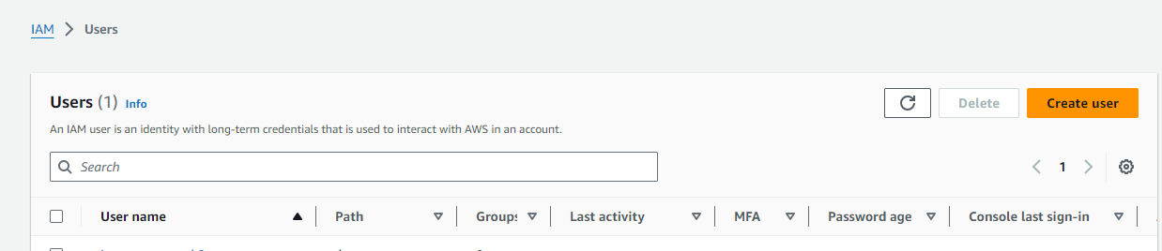


Slide 14
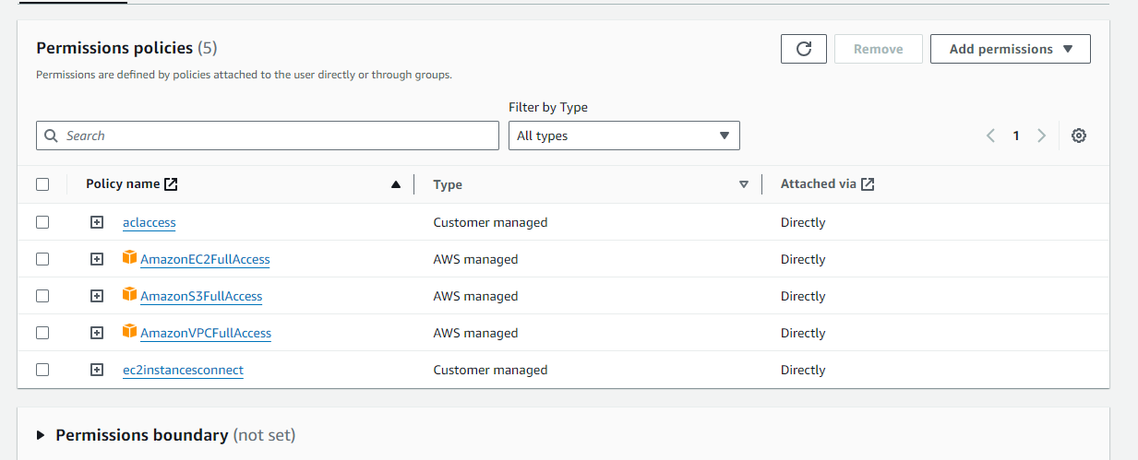
Attaching the permission:

Slide 15
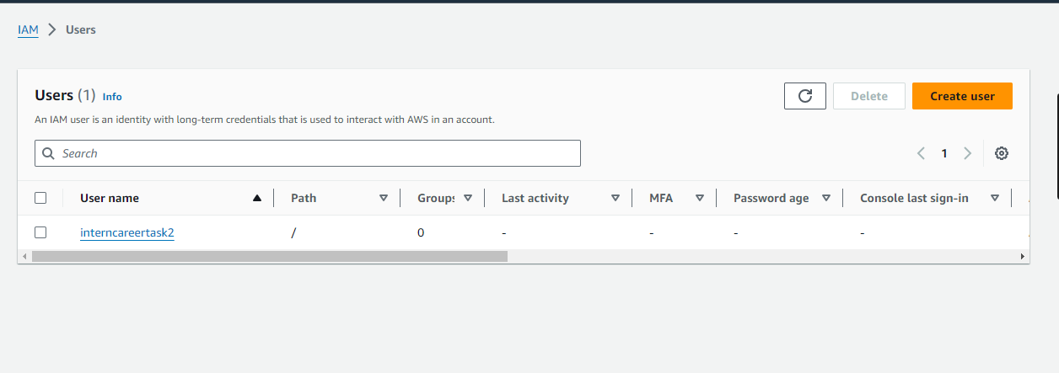
User created

Slide 16
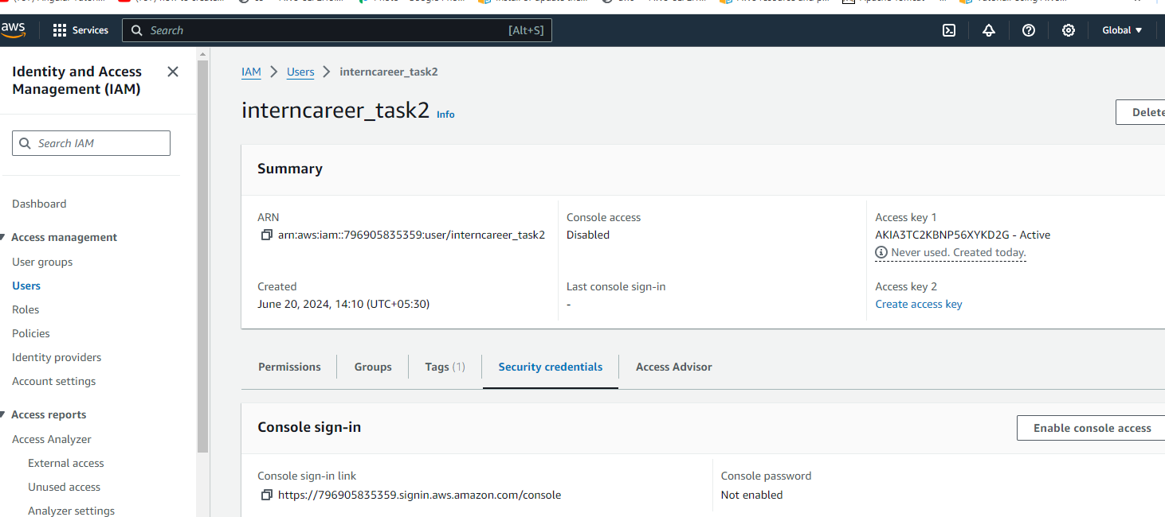
Generating the access key and secret key for the provider

Slide 17
5.Writing terraform script main.tf
provider "aws" {
access_key = "My_ACCESS_KEY"
secret_key = "MY_SECRTE_KEY"
region = "ap-south-1"
}
resource "aws_vpc" "app_vpc" {
cidr_block = "10.0.0.0/16"
tags = {
Name = "app_vpc"
}
}
resource "aws_internet_gateway" "igw" {
vpc_id = aws_vpc.app_vpc.id
tags = {
Name = "IGW"
}
}

Slide 18
resource "aws_subnet" "public_sub" {
vpc_id = aws_vpc.app_vpc.id
cidr_block = "10.0.1.0/24"
availability_zone = "ap-south-1a"
map_public_ip_on_launch = true
tags = {
Name = "public subnet"
}
}
esource "aws_route" "route_to_igw_default" {
route_table_id = aws_vpc.app_vpc.default_route_table_id
destination_cidr_block = "0.0.0.0/0"
gateway_id = aws_internet_gateway.igw.id
}

Slide 19
resource "aws_security_group" "test-sg" {
name = "test-sg"
description = "Enable web traffic for the project"
vpc_id = aws_vpc.app_vpc.id
//Inbound rule
ingress {
from_port = 22
to_port = 22
protocol = "tcp"
cidr_blocks = ["0.0.0.0/0"] # Allow SSH access from anywhere
}
ingress {
from_port = 8080 # Assuming HTTP runs on port 8080
to_port = 8080
protocol = "tcp"
cidr_blocks = ["0.0.0.0/0"] # Allow HTTP access from anywhere
}

Slide 20
// Outbound rule
egress {
from_port = 0
to_port = 0
protocol = "-1"
cidr_blocks = ["0.0.0.0/0"]
}
}
resource "aws_instance" "machine1"{
ami = "ami-0f58b397bc5c1f2e8"
instance_type = "t2.micro"
key_name = "linuxgit"
subnet_id = aws_subnet.public_sub.id
security_groups = [aws_security_group.test-sg.id]
tags = {
Name = "test1"
}
}

Slide 21
resource "aws_s3_bucket" "my_bucket" {
bucket = "my-interncareertask2"
}
resource "aws_s3_bucket_ownership_controls" "my_bucket_owner" {
bucket = aws_s3_bucket.my_bucket.id
rule {
object_ownership = "BucketOwnerPreferred"
}
}
resource "aws_s3_bucket_public_access_block" "my_bucket_access" {
bucket = aws_s3_bucket.my_bucket.id
block_public_acls = false
block_public_policy = false
ignore_public_acls = false
restrict_public_buckets = false
}

Slide 22
resource "aws_s3_bucket_acl" "my_bucket_owner" {
depends_on = [
aws_s3_bucket_public_access_block.my_bucket_access,
aws_s3_bucket_ownership_controls.my_bucket_owner,
]
bucket = aws_s3_bucket.my_bucket.id
acl = "public-read"
}
# Attach a bucket policy to allow public read access
resource "aws_s3_bucket_policy" "my_bucket_policy" {
bucket = aws_s3_bucket.my_bucket.id

Slide 23
policy = jsonencode({
Version = "2012-10-17"
Statement = [
{
Effect = "Allow"
Principal = "*"
Action = "s3:GetObject"
Resource = "${aws_s3_bucket.my_bucket.arn}/*"
}
]
})
}
resource "aws_s3_object" "Index" {
bucket = aws_s3_bucket.my_bucket.id
key = "index.html"
source = "index.html"
acl = "public-read"
content_type = "text/html"
}

Slide 24
resource "aws_s3_object" "error" {
bucket = aws_s3_bucket.my_bucket.id
key = "error.html"
source = "error.html"
acl = "public-read"
content_type = "text/html"
}
resource "aws_s3_bucket_website_configuration" "website" {
bucket = aws_s3_bucket.my_bucket.id
index_document {
suffix = "index.html"
}
error_document {
key = "error.html"
}
depends_on = [ aws_s3_bucket_acl.my_bucket_owner ]
}

Slide 25
Output.tf
output "websiteendpoint"{
value = aws_s3_bucket.mybucket.website_endpoint
}

Slide 26
backend.tf
terraform {
backend "s3" {
bucket = "my-interncareertask213"
key = "terraform.tfstate"
region = "ap-south-1"
access_key = "My_ACCESS_KEY"
secret_key = "MY_SECRTE_KEY"
}
}

Slide 27
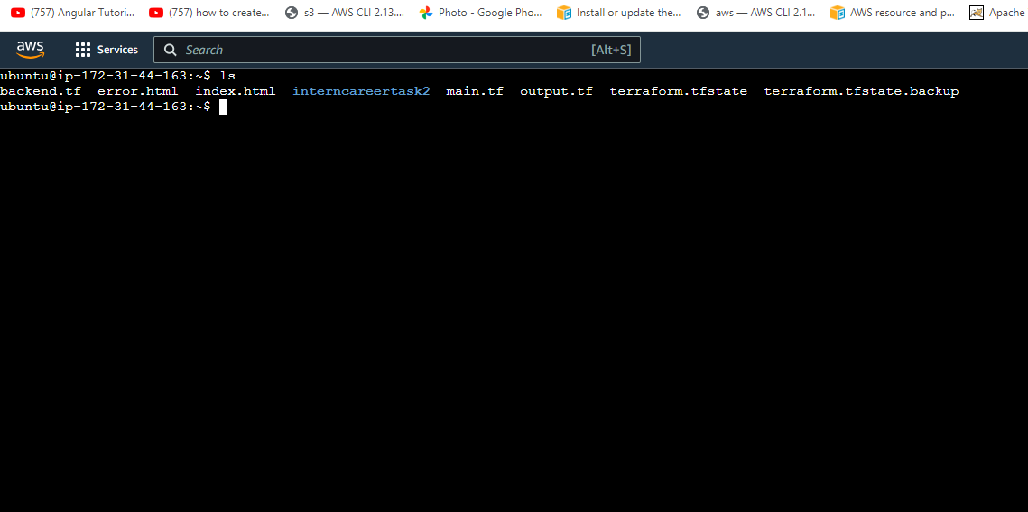

Slide 28
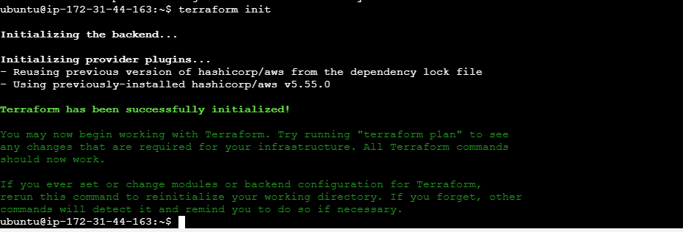
Initial the terraform through
Terraform init:

Slide 29
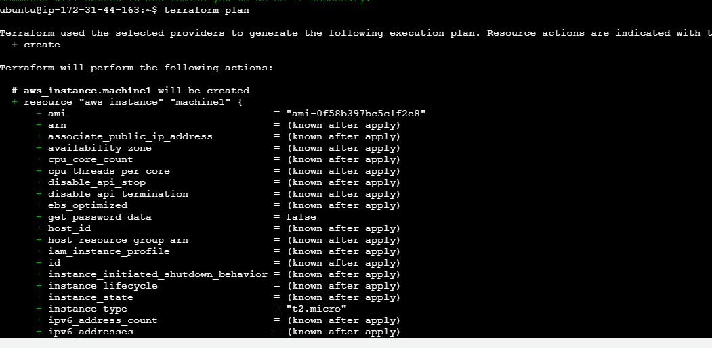
Make a dry run by
Terraform plan

Slide 30
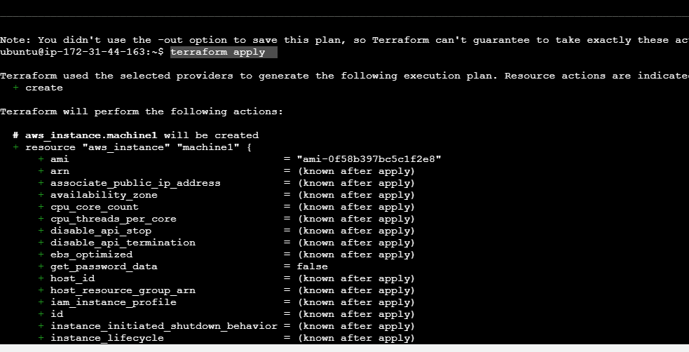
Creating the resources by
terraform apply

Slide 31
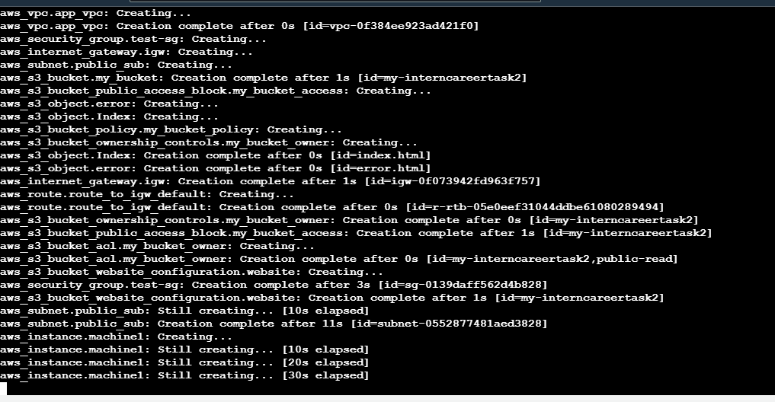

Slide 32
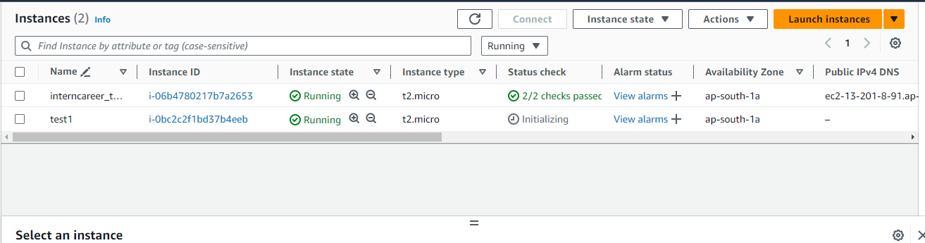


Ec2 instance created :

Slide 33
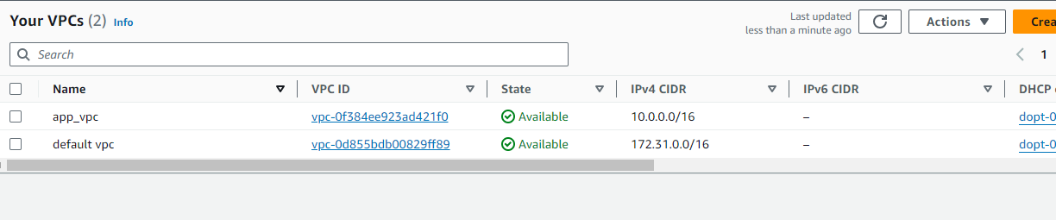

Vpc created :

Slide 34
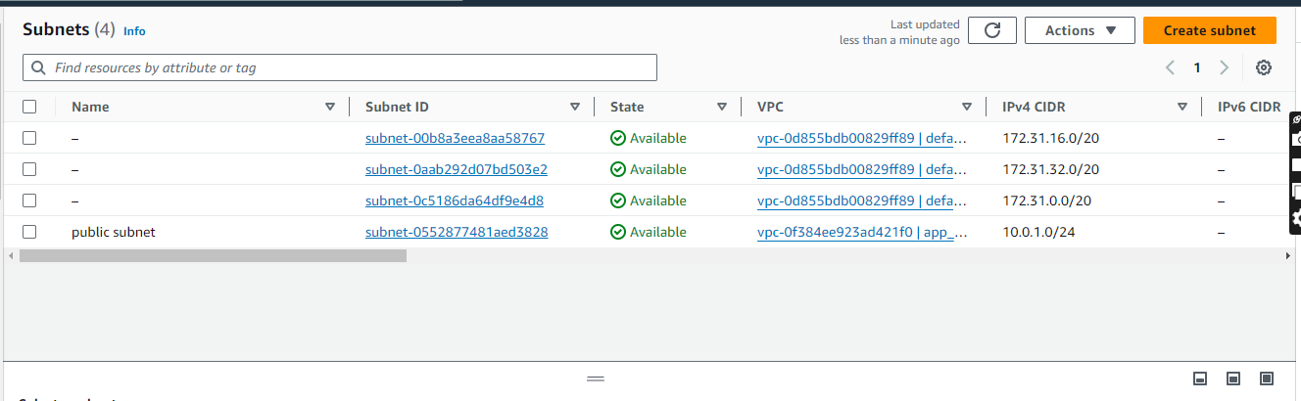
Subnet created :

Slide 35
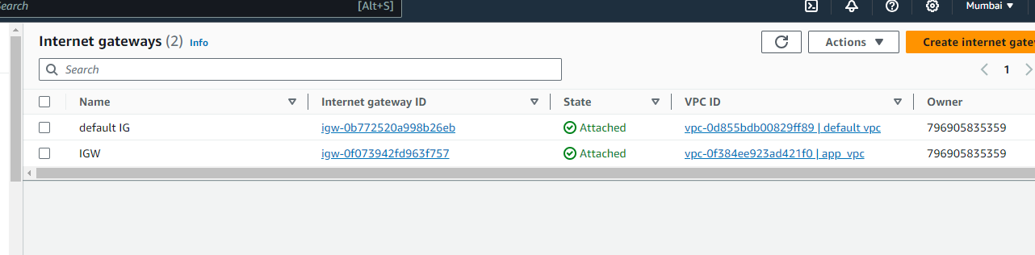
Internet gateway created

Slide 36
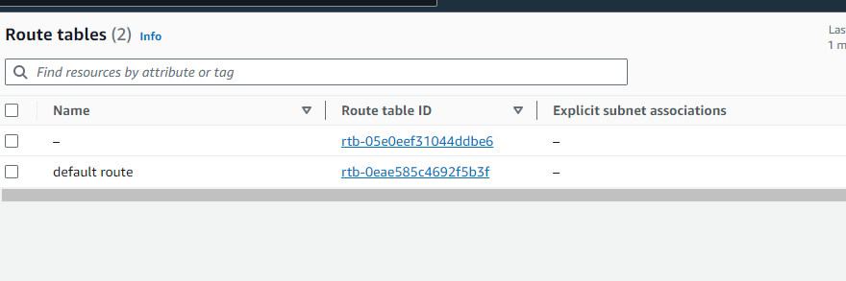
Route table created

Slide 37
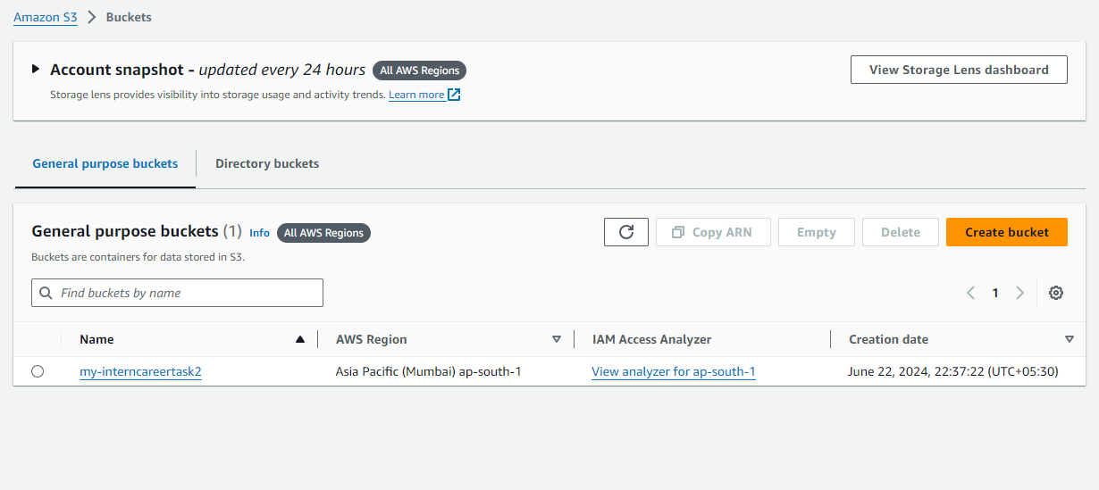
S3 bucket created

Slide 38
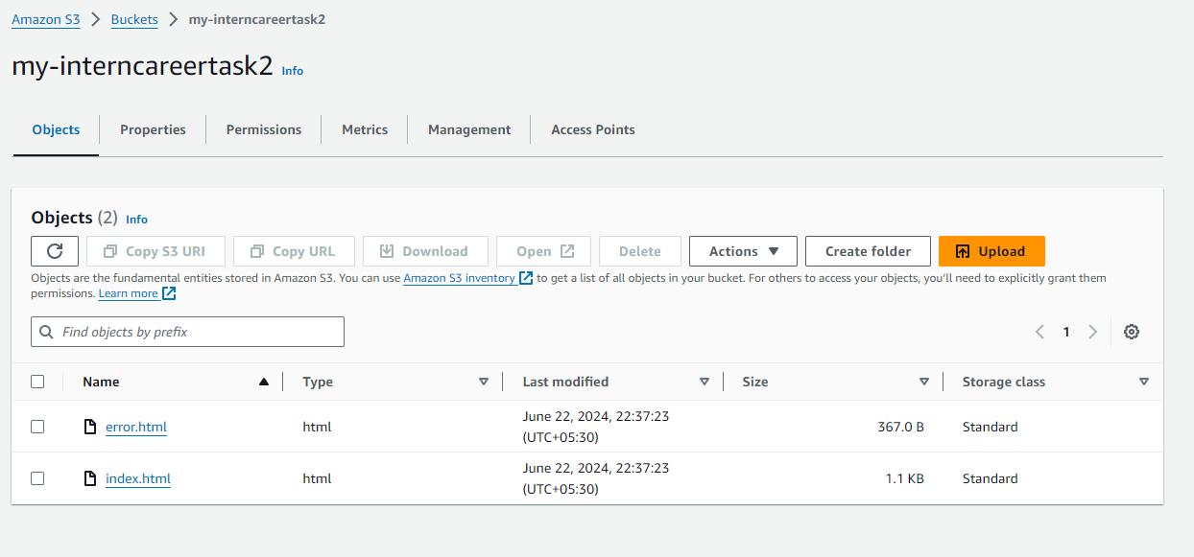
Object uploaded in s3:

Slide 39
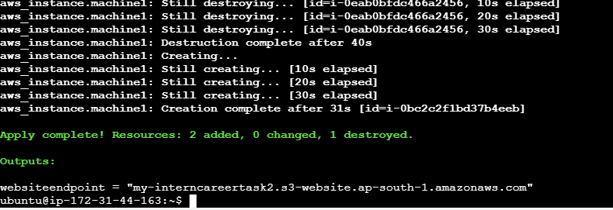
Output of the website :

Slide 40
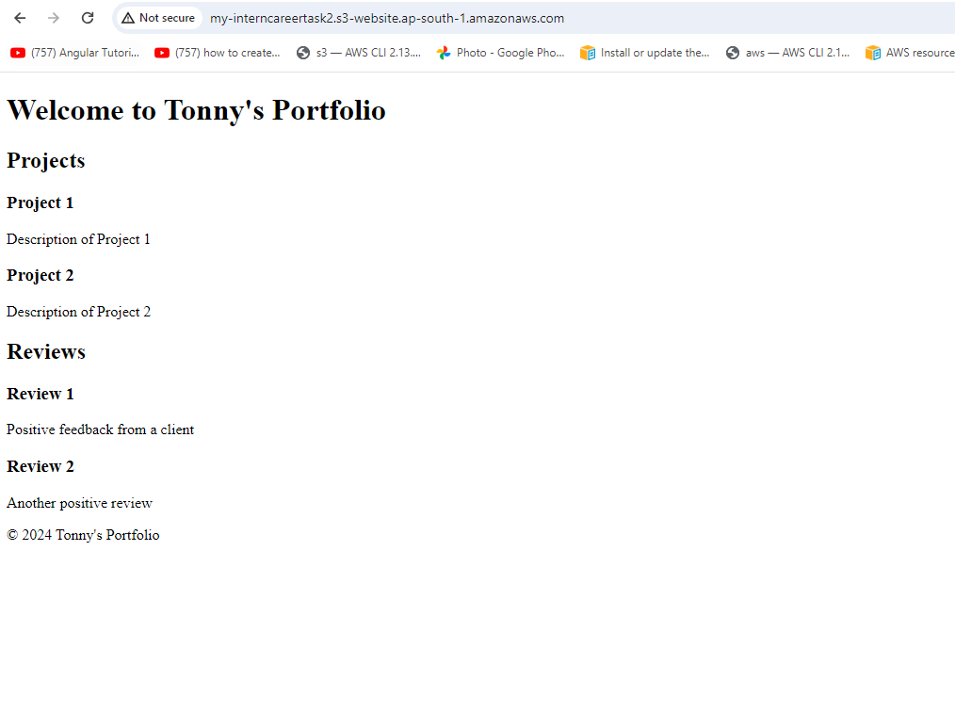
The website hosted:

Slide 41
Storing data in s3
Created the s3 bucket
Wrote the backen.tf file

Slide 42
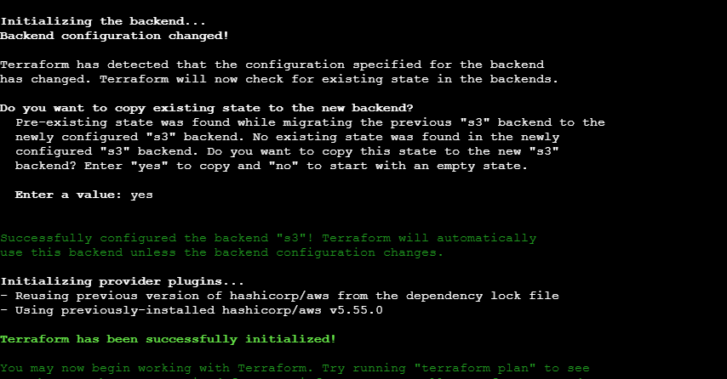
The files copied to the s3 I created manually

Slide 43
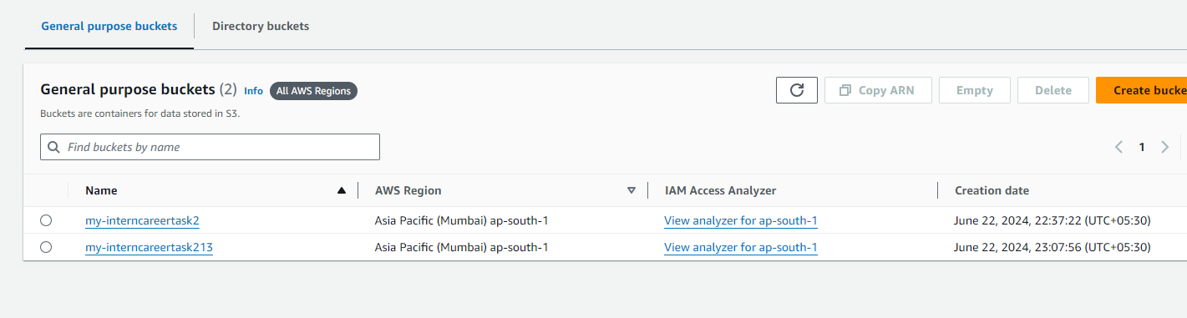

Slide 44
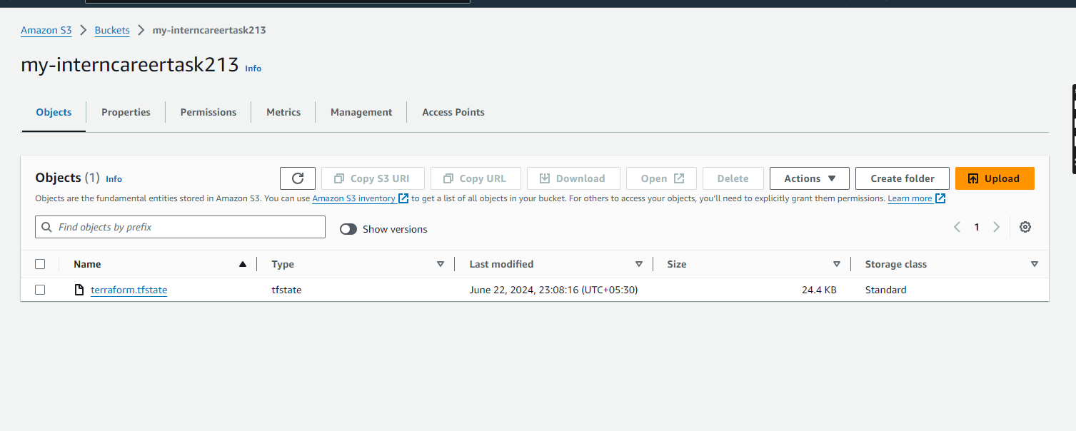

Slide 45
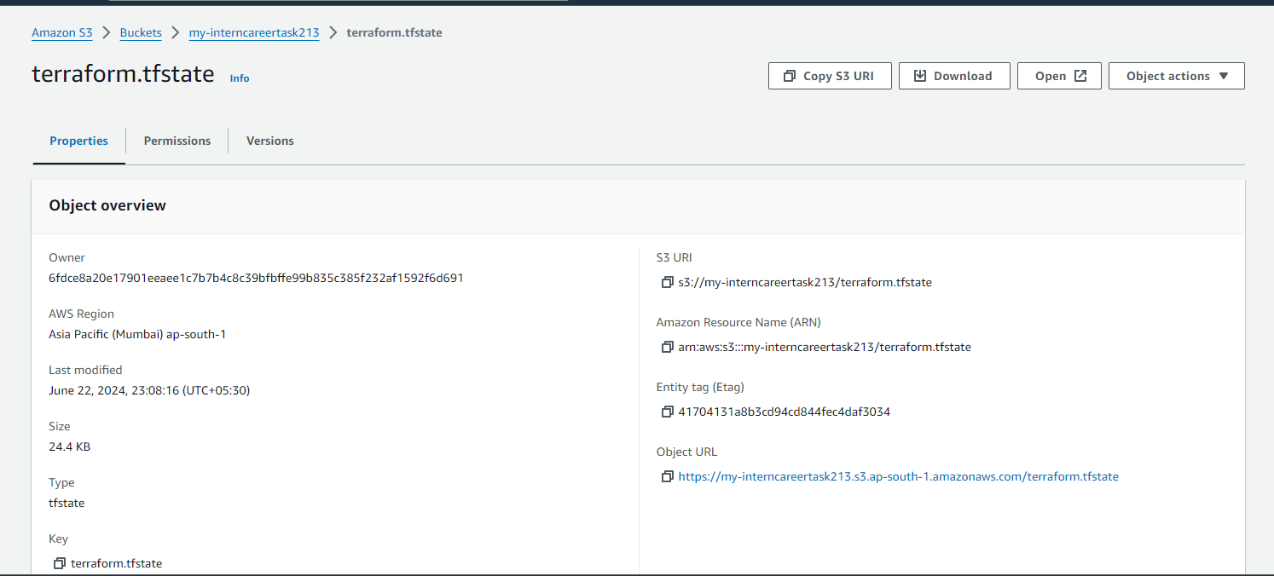

Slide 46
Conclusion
Hence the Ec2 instance ,networking components and s3 was created

